Slide 1
CodePerspective
Brendan Forster
@shiftkey
what even is it?

Slide 2


Slide 3

- how to use it - shenanigans - The Third Act

Slide 4

- instrumentation - profiling - visualizations

Slide 5
profiling tools
a totally unscientific chart
windbg
information
dotTrace
visual studio
glimpse
barrier to entry

Slide 6
profiling tools
a totally unscientific chart
windbg
information
dotTrace
visual studio
glimpse
CodePerspective
barrier to entry

Slide 7
Viewer
IPC Pipes (local)
TCP Server (remote)
XRay
.NET Assemblies
Instrumented
.NET Assemblies

Slide 8


Slide 9
let’s code some stuff

Slide 10

codeperspective.com

Slide 11
[opinions]

Slide 12


Slide 13
you can tell a
DEVELOPER
was behind this

Slide 14


Slide 15
you can tell a
DEVELOPER
was behind this

Slide 16
WPF support is broken Don’t precompile your MVC application

Slide 17
record and replay?

Slide 18
Viewer
Viewer
IPC Pipes (local)
TCP Server (remote)
EventStore
Instrumented
.NET Assemblies
Instrumented
.NET Assemblies

Slide 19
Viewer
Viewer
IPC Pipes (local)
TCP Server (remote)
Logs
Events
EventStore
Instrumented
.NET Assemblies
Instrumented
.NET Assemblies

Slide 20


Slide 21
it’s open source*

Slide 22
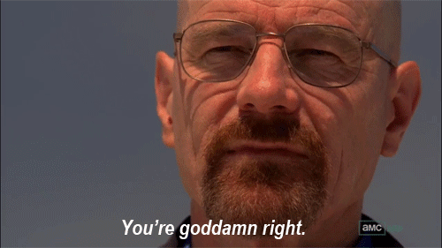

Slide 23
* AGPL

Slide 24
* it has no tests

Slide 25

* it has no tests

Slide 26

fin

